Slide 1

How Cybercrime Bypasses common security controls in the enterprises
Richard Rushing
CISO of Motorola Mobility （a Lenovo Company）

Slide 2
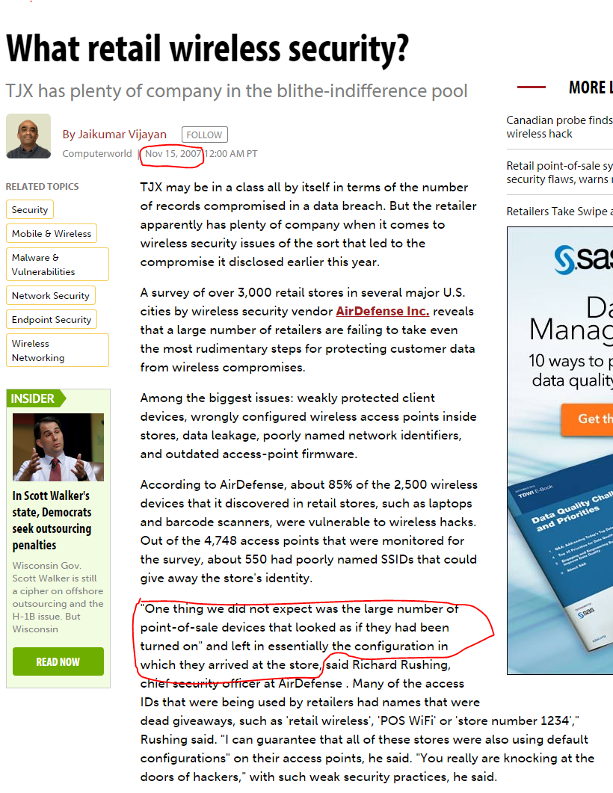
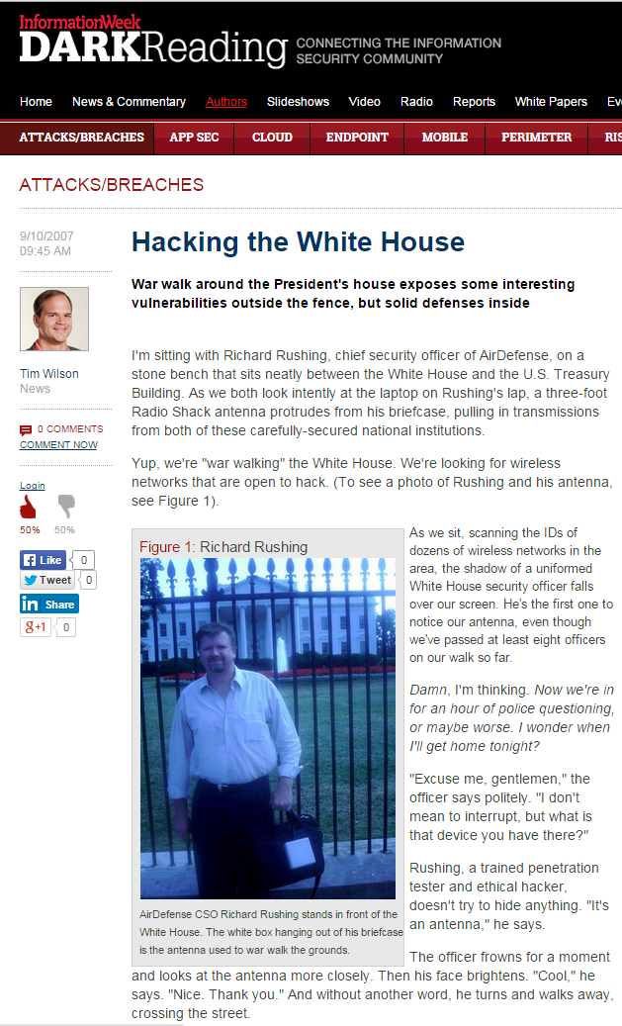
About ME
About Me
CISO of Motorola Mobility
- @secrich – On Twitter
- Have a Crazy Family all part of the fun
- Been Doing this way to LONG
Security Startup Veteran
- SecureIT, Verisign, AirDefense
Corporate Veteran (Siemens, GE, Moto)
We can only improve by adding Complexity we are so….

Slide 3
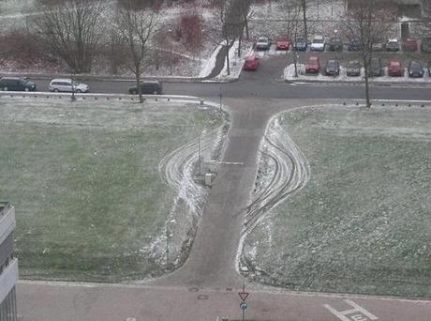
Definition of Bypass
noun
a road passing around a town or its center to provide an alternative route for through traffic.
synonyms: detour, alternative route, diversion, shortcut
verb
Go past or around.
"bypass the farm and continue to the road"
synonyms: go around, go past, make a detour around;

Slide 4
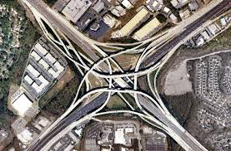
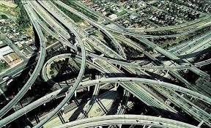
Items covered
Network Controls
- Firewalls
- Web Application Firewalls
- Sandboxes
- Traffic
Endpoint Controls
- Antivirus
- Exploit Mitigation
- Advance Detection

Slide 5
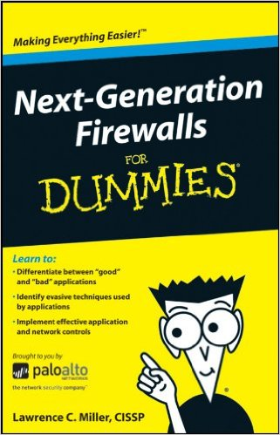
Network controls--Firewalls
Even Scanner like NMAP can tell information
- Handshakes, Options, Resets, etc.
Next Generation Firewall
– Needs to allow more traffic to determine if to block
- UDP rules them all
IPV6 configuration never matches IPv4
- CRC, Fragments, So many ways
Your Firewall Hides NOTHING!
Notes:
https://pentestlab.blog/2012/04/02/nmap-techniques-for-avoiding-firewalls/

Slide 6
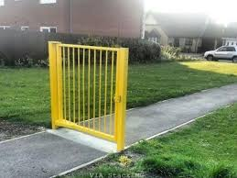
Network controls-- Firewalls
Application specific rules require more packets
- Packets will pass thru the firewall
- Can be as much as 35 packets before being blocked
So understand what application types
- Allows for the best results
- Many Exploits are Blocked by Signature
- Customized the specific exploit
Encryption is your friend

Slide 7
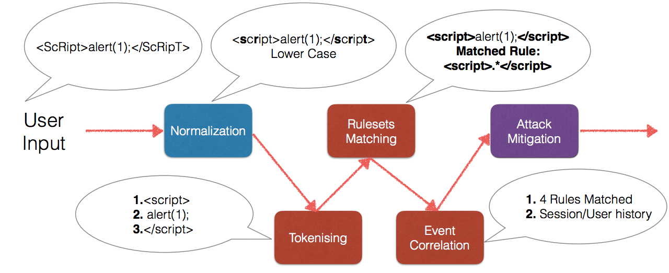
Web Application Firewall （WAF)
Over 250 protocol-level evasion techniques have been released
- Automating WAF Fingerprinting with Burp, Nmap and wafw00f
HTTP Parameter Pollution – HPP
- Encoding Techniques for Bypassing
- HTTP Parameter Fragmentation – HPF
- Remote File Inclusion for WAF Bypassing

Slide 8

File Impersonation
What determines the format of the file
- Most of the time the extension is just used
- Can use an Exploit
- Can you embedded other code
JPG images great place
- If viewed with Browser
- JPG Modified to be JavaScript, Or other format.
Many other formats to use, Browser is the weak link

Slide 9
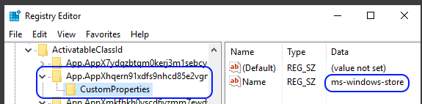
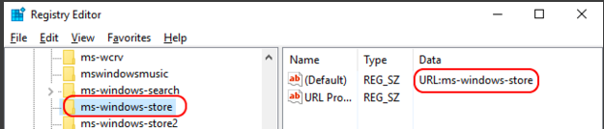
Browsers – Loading Files
New Protocols all the time
- New unrestricted applications ☺
- ms-windowstore://collection/?CollectionId=
URL Interesting
- Enumerate all loadable protocols
- Which apps accept arguments so we can try to inject code
- (binary or pure JavaScript, depending on how the app was coded and how it treats the arguments Files

Slide 10
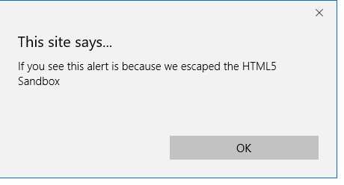
Sandbox
HTML5 Sandbox
- Impose restrictions to a webpage using the sandbox iframe attribute or the sandbox http header.
- <iframe src=”sandboxed.html” sandbox></iframe>
If you can escape,is it a sandbox?

Slide 11
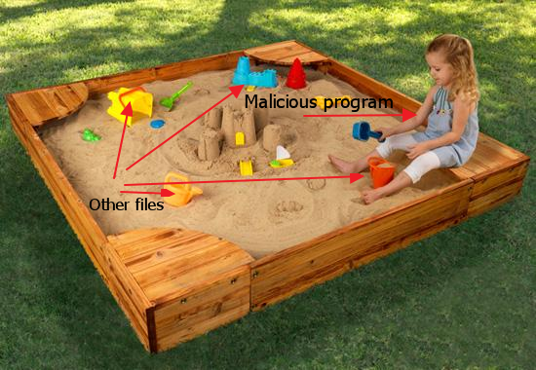
Sandbox
Waiting
Waiting More……
New ways to see if your in a Sandbox
- # CPU’s
- Count CPU Cycles
- Embed Another document, Powerpoint inside and Excel file
Just be good at the time of scanning

Slide 12
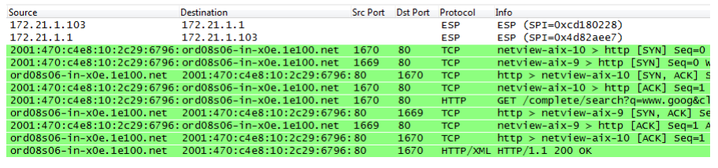
Endpoint Proxy/VPN
IPV6 is rarely used but always configured
- IPv6 usually bypass most attempts to pick up Configuration issues
- If the system receives an IPv6 Router Advertisement it will immediately configure IPv6
This may include a global address, a default route, and a new DNS server

Slide 13

Bypassing Endpoints
How do they do it
- Hooking
- Malware – Man-in-the-Middle/Browser
- Anti-Exploit – EMET, Traps,etc..
- APM – Application Performance Monitoring
- Application Virtualization –Microsoft App-V
- 3rd Party Personal Firewalls – Zone-Alarm
- Managed by a Kernel to User Injected DLL

Slide 14
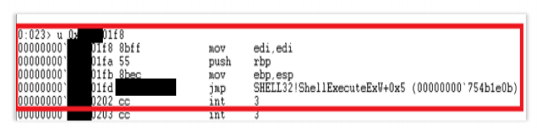
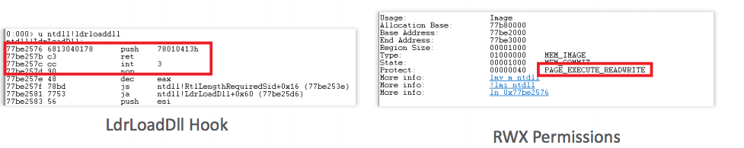
Hooking Issues
Unsafe Injection
Predictable RWX Code Stubs
Predictable RX Code Stubs
ASLR bypass – OS functions
Hook Bypass – Call Hook
RWX Hook code Stubs
RWX Hooked Modules

Slide 15
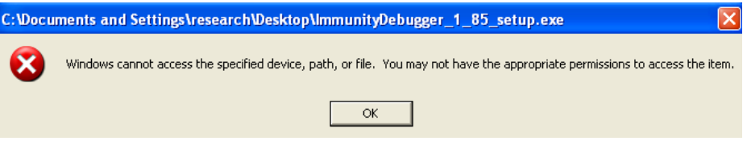
Application Whitelisting
Applications can only be executed that are allowed
- Bit9, AppLocker, Coretrace
Find Applications that are Approved and can be used to execute code
- Office, POWERSHELL,
- DllInjection, PE-File Injection, Invoke Shellcode，Keylogging, Basic Code Execution – Scripts, Stating or Ending Applications
- Full Code Execution - Injection/Execution

Slide 16
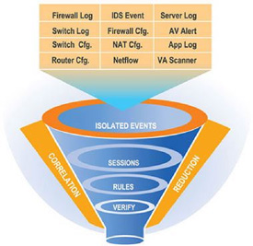
Security Logging Tools
SIEMs
- Recording all the data
- Determine Issues and Problems
Bypass
- Critical issues in Logging – Source, Destination
- Critical Levels control by Clients
- Time always WIN – Set to 2 years in the future
- NTP intercept, Change, or TimeZone

Slide 17
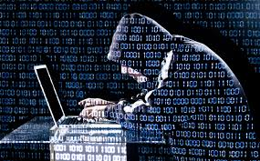
Take Away
Plenty of ways around ALL Security Technology
- Nothing works 100% percent
- Endpoints are the Easy Part
Solutions
- Defense in Depth
- Detection in Depth
- Variance is the key to success
Different Solutions vs. Single Solution

Slide 18
Thank You!

